Slide 1
Exception Handling in Java

Slide 2
Exception in Java
In Java, an exception is an event that disrupts the normal flow of the program.
When an exception occurs program execution gets terminated abnormally, which is not recommended, therefore, these exceptions are to be handled in java.

Slide 3
Cont…
Example:
statement 1;
statement 2;
statement 3;
statement 4;
statement 5;//exception occurs
statement 6;
statement 7;
statement 8;
statement 9;
statement 10;

Slide 4
Cont…
Suppose there are 10 statements in your program and there occurs an exception at statement 5, the rest of the code will not be executed i.e. statement 6 to 10 will not be executed.

Slide 5
Cont…
Following are some scenarios where an exception occurs.
  A user has entered an invalid data.
  A file that needs to be opened cannot be found.
  A network connection has been lost in the middle of communications.

Slide 6
Exception Handling in Java
The Exception Handling is the powerful mechanism to handle the runtime errors caused by exceptions.
Example: IOException, ArithmeticException, etc
Normal flow of the application can be maintained

Slide 7
Advantage of Exception Handling
The core advantage of exception handling is to maintain the normal flow of the application .

Slide 8
Cont…
Example:
statement 1;
statement 2;
statement 3;
statement 4;
statement 5;//exception occurs
statement 6;
statement 7;
statement 8;
statement 9;
statement 10;

Slide 9
Cont…
Suppose there are 10 statements in your program and there occurs an exception at statement 5, the rest of the code will not be executed i.e. statement 6 to 10 will not be executed.
If we perform exception handling, the rest of the statement will be executed.
That is why we use exception handling in Java.

Slide 10
Hierarchy of Java Exception classes
The java.lang.Throwable class is the root class of Java Exception hierarchy .

Slide 11
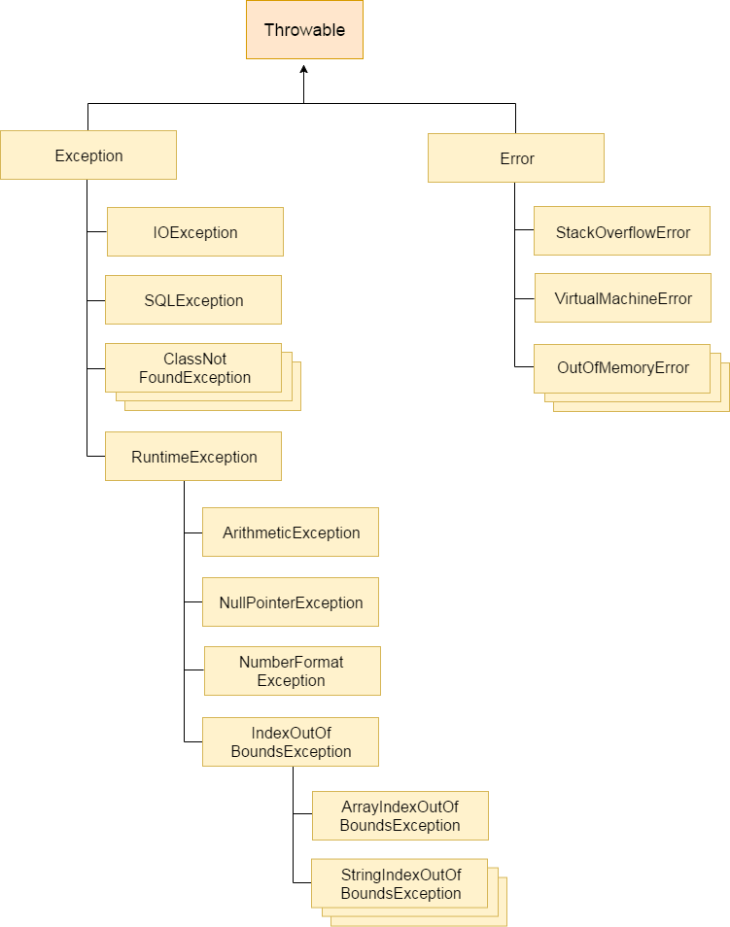

Slide 12
Types of Java Exception
There are mainly two types of exceptions.
  Checked Exception.
  Unchecked Exception.
Checked Exception : A checked exception is an exception that is checked (notified) by the compiler at compilation-time.

Slide 13
Cont…
These are also called as compile time exceptions.
Example: IOException, SQLException etc.

Slide 14
Cont…
2. Unchecked Exception: An unchecked exception is an exception that occurs at the time of execution.
Example: ArithmeticException,
ArrayIndexOutOfBoundsException etc.
These are also called as Runtime Exceptions.

Slide 15
Common Scenarios of Java Exceptions
There are given some scenarios where unchecked exceptions may occur. They are as follows:
A scenario where ArithmeticException occurs .
  If we divide any number by zero, there occurs an ArithmeticException.
Example:
int a=50/0; //ArithmeticException

Slide 16
Cont…
A scenario where ArrayIndexOutOfBoundsException occurs.
If you are inserting any value in the wrong index, it would result in ArrayIndexOutOfBoundsException.
Example:
int a[]=new int[5];
a[10]=50; //ArrayIndexOutOfBoundsException

Slide 17
Example:
// A.java
class A
{
  public static void main(String a[])
  {
    int num[] = {1, 2, 3, 4};
    System.out.println(num[5]);
    System.out.println(“Rest of the code“);
  }
}
Output
Exception in thread "main" java.lang.ArrayIndexOutOfBoundsException: Index 5 out of bounds for length 4 at A.main(A.java:6)

Slide 18
Java Exception Keywords
There are following Exception Keywords.
  try
  catch
  finally
  throw
  throws

Slide 19
Cont…
Keyword | Description
try | The "try" keyword is used to specify a block where we should place an exception code. It means we can't use try block alone. The try block must be followed by either catch or finally.
catch | The "catch" block is used to handle the exception. It must be preceded by try block which means we can't use catch block alone. It can be followed by finally block later.

Slide 20
Cont…
finally | The "finally" block is used to execute the necessary code of the program. It is executed whether an exception is handled or not.
throw | The "throw" keyword is used to throw an exception.
throws | The "throws" keyword is used to declare exceptions. It specifies that there may occur an exception in the method. It doesn't throw an exception. It is always used with method signature

Slide 21
Try block
The "try" keyword is used to specify a block and that block is called try block .
The try block is used to enclose the code that might throw an exception.
It must be used within the method.

Slide 22
Cont…
The try block must be followed by either catch or finally block.
Syntax of try block
try
{
//statements that may cause an exception
}

Slide 23
catch block
The "catch" keyword is used to specify a block and that block is called catch block.
The "catch" block is used to handle the exception.

Slide 24
Cont…
The catch block must be used after the try block only.
We can't use catch block alone.
It can be followed by finally block later.

Slide 25
Cont…
You can use multiple catch block with a single try block.
Syntax of catch block:
catch(ExceptionClassName e)
{
// Block of code to handle errors
}

Slide 26
Syntax of try catch in java
try
{
//statements that may cause an exception
}
catch(ExceptionClassName e)
{
// Block of code to handle errors
}

Slide 27
Example 1
class A
{
public static void main(String a[])
{
try
{
int data=50/0;
}
catch(ArithmeticException e)
{
System.out.println(“ArithmeticException”);
}
System.out.println("rest of the code");
}
}
Output:
ArithmeticException
rest of the code

Slide 28
Java finally block
Java finally block is always executed whether an exception is handled or not.
Java finally block is a block used to execute important code such as closing the connection, closing a file etc.
If you don't handle the exception, before terminating the program, JVM executes finally block (if any).

Slide 29
Example
Output:
Finally Block
Exception in thread "main" java.lang.ArithmeticException: / by zero
at B.main(B.java:8)
class B
{
  public static void main(String X[])
  {
    int a, b=10;
    try
    {
      a = b/0;
    }
    finally
    {
      System.out.println("Finally Block");
    }
  }
}

Slide 30
Java throw keyword
The Java throw keyword is used to throw an exception explicitly.
We can throw either checked or unchecked exceptions in Java by throw keyword.

Slide 31
Example
class A
{
  void validate(int age)
  {
    if(age<18)
    {
      try
      {
        throw new ArithmeticException();
      }
      catch(ArithmeticException e)
      {
        System.out.println("ArithmeticException");
      }
  }
    else
    {
      System.out.println("Person is eligible to vote");
    }
  }
  public static void main(String X[])
  {
  A a1 = new A();
  a1.validate(15);
  }
}
Output:
ArithmeticException

Slide 32
Java throws keyword
The Java throws keyword is used to declare an exception.
It is always used with method signature
It specifies that there may occur an exception in the method.

Slide 33
Cont…
It gives an information to the programmer that there may occur an exception.
It doesn't throw an exception.

Slide 34
Example
class B
{
  int x, y=90;
  void divide() throws ArithmeticException
  {
  x = y/0;
  }
  public static void main(String a[])
{
B b1 = new B();
try
{
b1.divide();
}
catch(ArithmeticException e)
{
System.out.println("Arithmetic Exception");
}
System.out.println("rest of the code");
}
}

Slide 35
Cont…
Output:
Arithmetic Exception
rest of the code

Slide 36
Java Custom Exception
In Java, we can create our own exceptions is known as custom exception or user-defined exception.
Basically, Java custom exceptions are used to customize the exception according to user need.

Slide 37
Example
class InvalidAgeException extends RuntimeException
{
}

Slide 38
class D
{
  void validate(int age)
  {
  if(age<18)
  {
    try
    {
    throw new InvalidAgeException();
    }
    catch(InvalidAgeException e)
    {
    System.out.println("Invalid Age Exception");
    }
  }
  else
  {
    System.out.println("Person is eligible to vote");
  }
  }
  public static void main(String X[])
  {
  D a1 = new D();
  a1.validate(13);
  }
}

Slide 39
Cont…
Output:
Invalid Age Exception

Slide 40
Example: Try Block with multiple catch block
class A
{
  public static void main( String a[])
  {
  int b[] = new int[3];
    try
    {
      b[3] = 10/0;
    }
    catch(ArrayIndexOutOfBoundsException e)
    {
      System.out.println("ArrayIndexOutOfBoundsException");
    }
    catch(ArithmeticException e)
    {
      System.out.println("ArithmeticException");
    }
    System.out.println("rest of the code");
  }
}

Slide 41
Cont…
Output:
ArithmeticException
rest of the code

